Slide 1
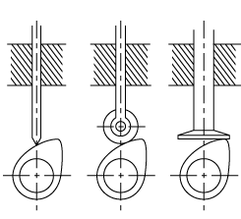
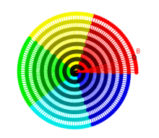
Cam and Follower

Slide 2

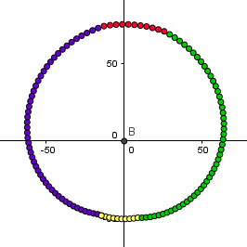
CAM AND FOLLOWER (IN GEOGEBRA)

Slide 3
Cam Generation theory.
Displacement diagram.
Checking With the help of Displacement Diagram maximum acceleration and maximum Velocity.
If they are Safe then points are plotted.
To be traced on Geogebra.
Movement of follower to be checked.
Can Be used for motion analysis purpose.

Slide 4
Displacement Diagram
Dwell
Increase
Decrease
Dwell
Angle

Slide 5
Representation in Geogebra
Dwell-Yellow
Rising Side- Green
Dwell-Red
Falling Side-Blue

Slide 6
Actual Animation for better understanding.

Slide 7
Equation of points Defined
If name of Point is Point A
A=(50+c)*cos(a+b),(50+c)*sin(a+b)
Here,
c=Offset Displacement
a=actual Angle.
b=Angle for Slider(Motion Purpose)

Slide 8
Explanation of Equation
If we want equation of Circle
A=50*cos(a)+50*sin(a)
If we Add displacement to these points on circle.
A=(50+c)*cos(a)+(50+c)*sin(a)
If we want to add motion of Cam
A=(50+c)*cos(a+b)+(50+c)*sin(a+b)

